Slide 1
Container Probes

Slide 2
Why use Container Probes?
Probes allow Kubernetes to interact with your application to ensure it is healthy and not crashed, hung, etc
Helps us answer these questions:
Did the container start?
Is it running?
Is it ready to receive traffic?
Has this changed over time?
Kubernetes probes can be used to make a service more robust and more resilient
Notes:
K8s
* Start the

Slide 3
The kubelet can optionally perform and react to three kinds of probes on running Containers:
livenessProbe: Indicates whether the Container is running. If the liveness probe fails, the kubelet kills the Container, and the Container is subjected to its restart policy. If a Container does not provide a liveness probe, the default state is Success.
readinessProbe: Indicates whether the Container is ready to service requests. If the readiness probe fails, the endpoints controller removes the Pod’s IP address from the endpoints of all Services that match the Pod. The default state of readiness before the initial delay is Failure. If a Container does not provide a readiness probe, the default state is Success.
startupProbe: Indicates whether the application within the Container is started. All other probes are disabled if a startup probe is provided, until it succeeds. If the startup probe fails, the kubelet kills the Container, and the Container is subjected to its restart policy. If a Container does not provide a startup probe, the default state is Success.
Notes:
https://kubernetes.io/docs/concepts/workloads/pods/pod-lifecycle/#container-probes
Kubernetes uses liveness probes to know when to restart a container.
Kubernetes uses readiness probes to decide when the container is available for accepting traffic.

Slide 4
There are three types of handlers:
ExecAction: Executes a specified command inside the Container. The diagnostic is considered successful if the command exits with a status code of 0.
TCPSocketAction: Performs a TCP check against the Container’s IP address on a specified port. The diagnostic is considered successful if the port is open.
HTTPGetAction: Performs an HTTP Get request against the Container’s IP address on a specified port and path. The diagnostic is considered successful if the response has a status code greater than or equal to 200 and less than 400.
Notes:
https://kubernetes.io/docs/concepts/workloads/pods/pod-lifecycle/#container-probes

Slide 5
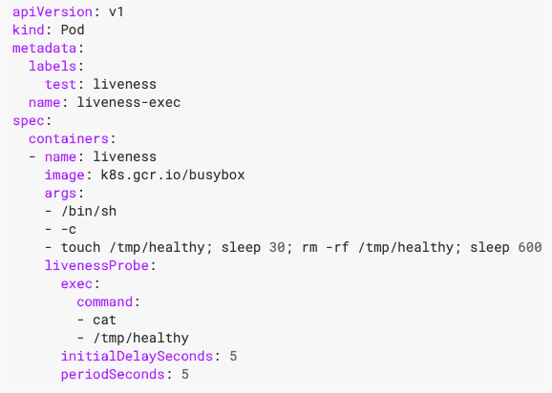
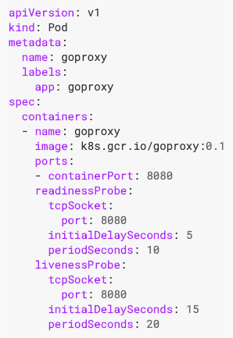
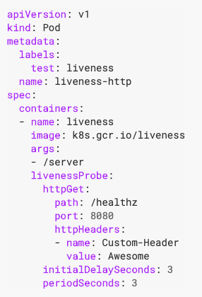
Handlers - Examples
ExecAction
TCPSocketAction
HTTPGetAction

Slide 6
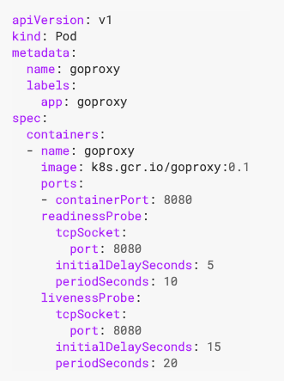
When should you use a liveness probe?
If the process in your Container is able to crash on its own whenever it encounters an issue or becomes unhealthy, you do not necessarily need a liveness probe; the kubelet will automatically perform the correct action in accordance with the Pod’s restartPolicy.
If you’d like your Container to be killed and restarted if a probe fails, then specify a liveness probe, and specify a restartPolicy of Always or OnFailure.
Notes:
https://kubernetes.io/docs/tasks/configure-pod-container/configure-liveness-readiness-startup-probes/

Slide 7
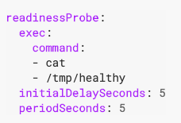
When should you use a readiness probe?
If you’d like to start sending traffic to a Pod only when a probe succeeds, specify a readiness probe. In this case, the readiness probe might be the same as the liveness probe, but the existence of the readiness probe in the spec means that the Pod will start without receiving any traffic and only start receiving traffic after the probe starts succeeding. If your Container needs to work on loading large data, configuration files, or migrations during startup, specify a readiness probe.
Notes:
https://kubernetes.io/docs/tasks/configure-pod-container/configure-liveness-readiness-startup-probes/

Slide 8
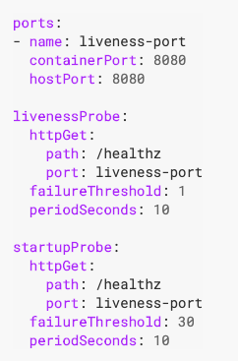
When should you use a startup probe?
If your Container usually starts in more than initialDelaySeconds + failureThreshold × periodSeconds, you should specify a startup probe that checks the same endpoint as the liveness probe. The default for periodSeconds is 30s. You should then set its failureThreshold high enough to allow the Container to start, without changing the default values of the liveness probe. This helps to protect against deadlocks.
Notes:
https://kubernetes.io/docs/tasks/configure-pod-container/configure-liveness-readiness-startup-probes/
Sometimes, you have to deal with legacy applications that might require an additional startup time on their first initialization. In such cases, it can be tricky to set up liveness probe parameters without compromising the fast response to deadlocks that motivated such a probe. The trick is to set up a startup probe with the same command, HTTP or TCP check, with a failureThreshold * periodSeconds long enough to cover the worse case startup time.
Thanks to the startup probe, the application will have a maximum of 5 minutes (30 * 10 = 300s) to finish its startup. Once the startup probe has succeeded once, the liveness probe takes over to provide a fast response to container deadlocks. If the startup probe never succeeds, the container is killed after 300s and subject to the pod’s restartPolicy.

